Slide 1

Bâtiment IMAG, Université Grenoble Alpes
700, avenue centrale
38401 Saint Martin d’Hères, France
http://www-verimag.imag.fr
Signal Temporal Logic Specifications
José-Ignacio Requeno
Alexey Bakhirkin
Nicolas Basset
Oded Maler*
Notes:
1
13/06/2018
Laboratoire Verimag

Slide 2
introduction
Introduction
Notes:
2
13/06/2018
Laboratoire Verimag

Slide 3
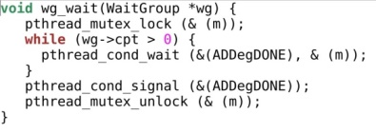
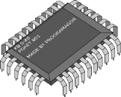

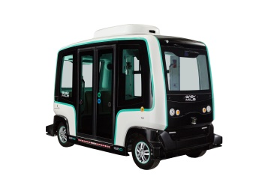
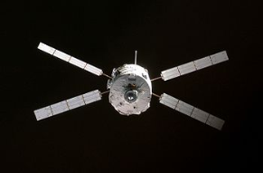
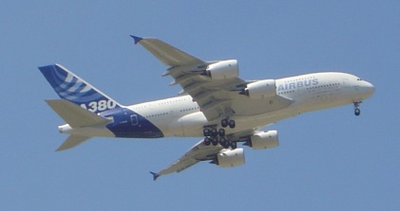
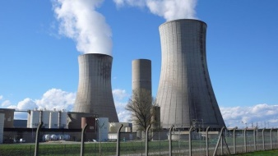

CYBER-PHYSICAL SYSTEMS
Cyber-Physical Systems:
hardware/software interacting with the physical environment
computerized control systems
uncertain / changing environment (timing constraints)
large scale, distributed / networked
Criticality:
safety (absence of errors)
security (resistance to attacks)
certification
Validation & Verification:
hybrid: discrete + real-time systems
+
© Antoine Heusse
© Sancio83
Notes:
3
13/06/2018
Laboratoire Verimag

Slide 4
CYBER-PHYSICAL SYSTEMS
Cyber-Physical Systems:
hardware/software interacting with the physical environment
computerized control systems
uncertain / changing environment (timing constraints)
large scale, distributed / networked
Criticality:
safety (absence of errors)
security (resistance to attacks)
certification
Validation & Verification:
hybrid: discrete + real-time systems
+
© Antoine Heusse
© Sancio83
Notes:
4
13/06/2018
Laboratoire Verimag

Slide 5
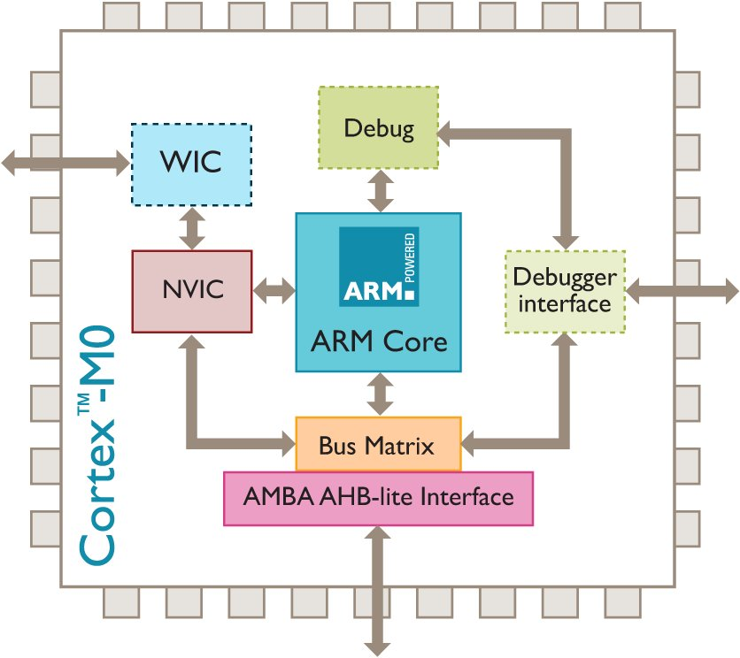
Hybrid system
Notes:
5
13/06/2018
Laboratoire Verimag

Slide 6
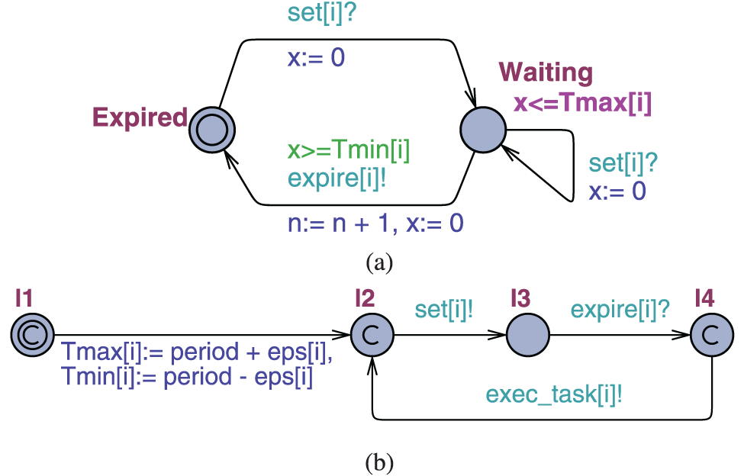
Hybrid system
Notes:
6
13/06/2018
Laboratoire Verimag

Slide 7
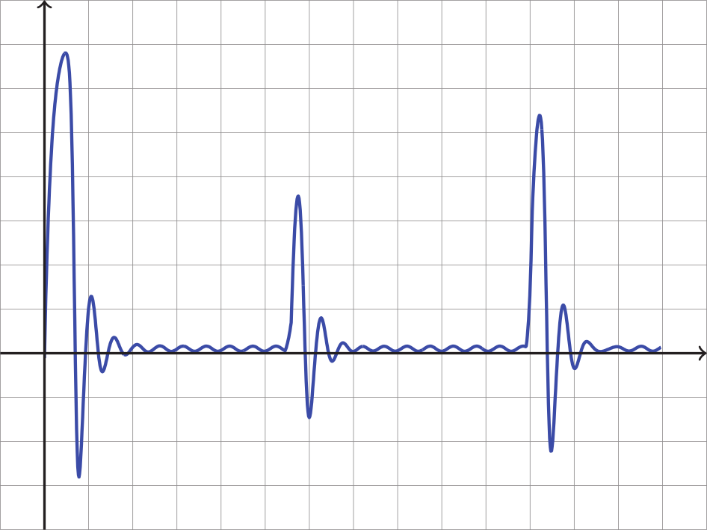
Hybrid system
*Rodriguez-Navas, G., & Proenza, J. (2013). Using timed automata for modeling distributed systems with clocks: Challenges and solutions. IEEE Transactions on Software Engineering, 39(6), 857-868.
Notes:
7
13/06/2018
Laboratoire Verimag

Slide 8
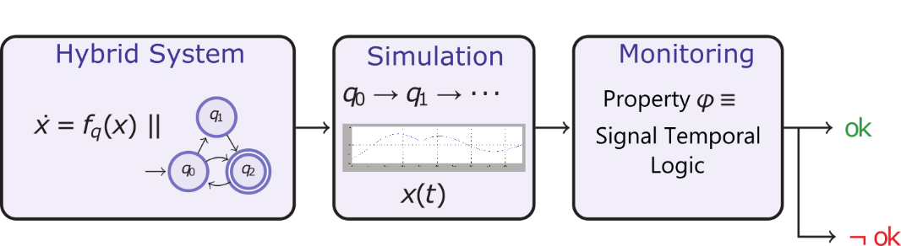
monitoring
Models are generally hybrid systems producing hybrid traces
Runtime verification (monitoring) analyses a single behavior at a time
Online: consumes the trace while the program still runs
Offline: consumes the trace after the execution is finished
Notes:
8
13/06/2018
Laboratoire Verimag

Slide 9
monitoring
Online monitoring is useful for:
Infinite traces
Reacting against bad events
Online monitoring requires efficient monitors in time and space
Runtime verification must be impartial and not anticipate
No monitor gives a verdict based on incomplete information
The monitor gives a verdict as soon as possible
Notes:
9
13/06/2018
Laboratoire Verimag

Slide 10
Temporal Logic
Temporal Logic for Signals
Notes:
10
13/06/2018
Laboratoire Verimag

Slide 11
Motivation
Notes:
11
13/06/2018
Laboratoire Verimag

Slide 12
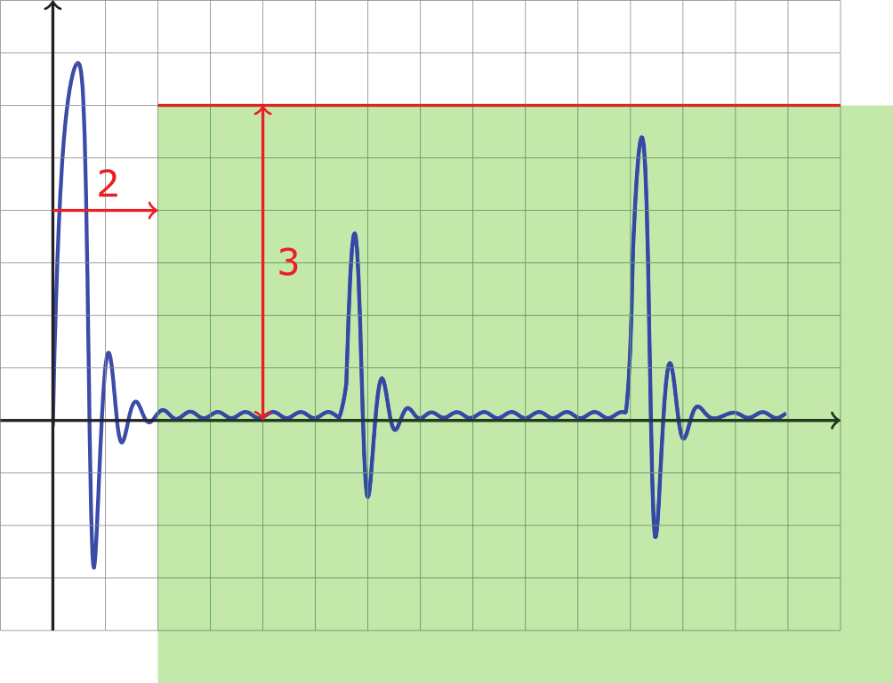
motivation
After 2s, the signal is never above 3
*Donzé, A.: On signal temporal logic. In: Legay, A., Bensalem, S. (eds.) RV 2013. LNCS, vol. 8174, pp. 382–383. Springer, Heidelberg (2013).
Notes:
12
13/06/2018
Laboratoire Verimag

Slide 13
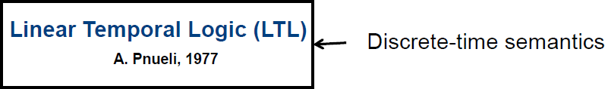
Signal temporal logic
Notes:
13
13/06/2018
Laboratoire Verimag

Slide 14
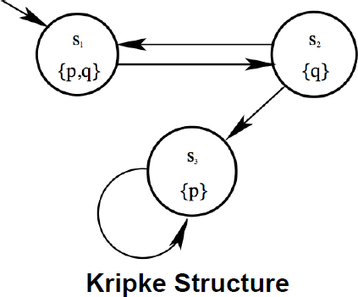
Signal temporal logic
…
…
…
…
…
…
Notes:
14
13/06/2018
Laboratoire Verimag

Slide 15
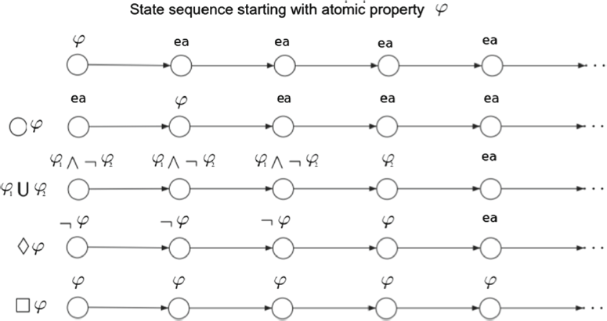
Signal temporal logic
Notes:
15
13/06/2018
Laboratoire Verimag

Slide 16
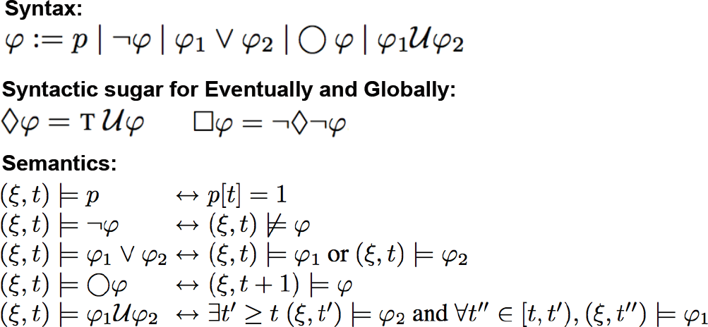
Signal temporal logic
Notes:
16
13/06/2018
Laboratoire Verimag

Slide 17
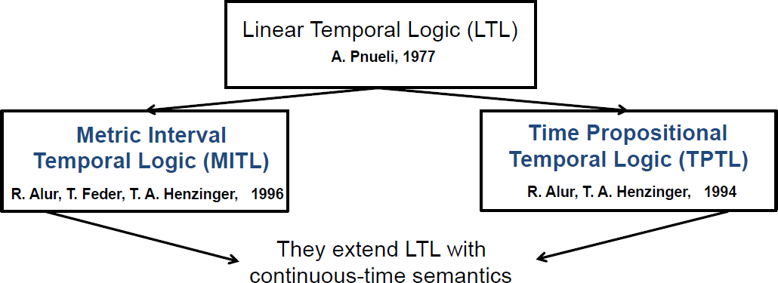
Signal temporal logic
Notes:
17
13/06/2018
Laboratoire Verimag

Slide 18
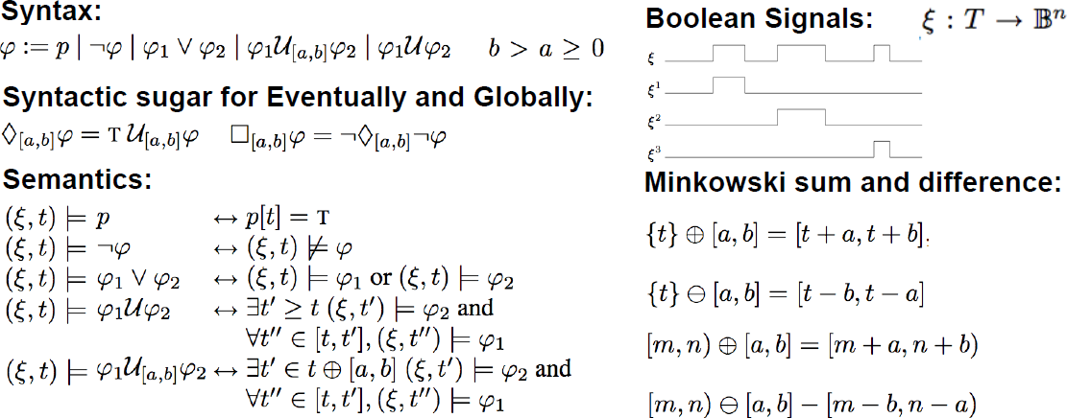
Signal temporal logic
Notes:
18
13/06/2018
Laboratoire Verimag

Slide 19
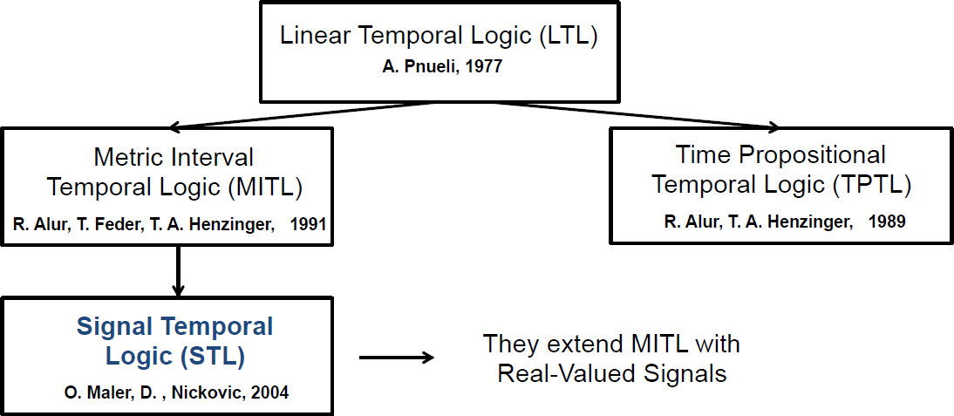
Signal temporal logic
Notes:
19
13/06/2018
Laboratoire Verimag

Slide 20
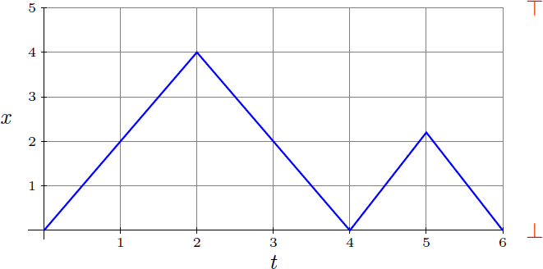
Signal temporal logic
Notes:
20
13/06/2018
Laboratoire Verimag

Slide 21
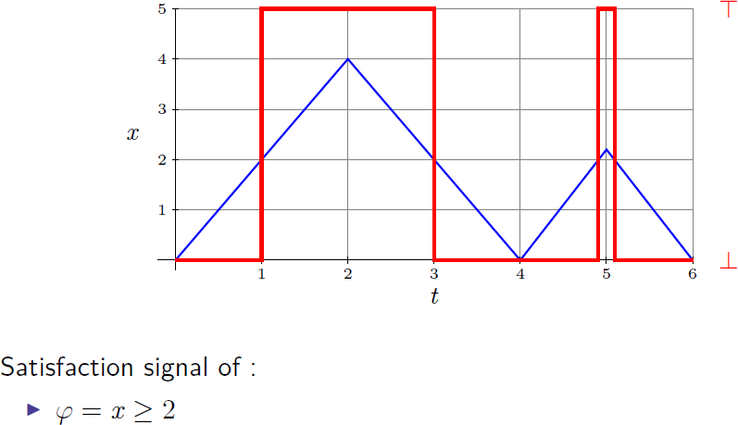
Signal temporal logic
Notes:
21
13/06/2018
Laboratoire Verimag

Slide 22
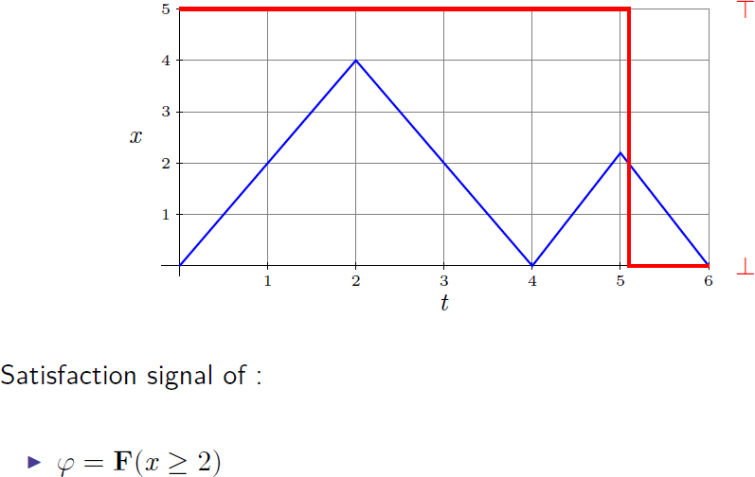
Signal temporal logic
Notes:
22
13/06/2018
Laboratoire Verimag

Slide 23
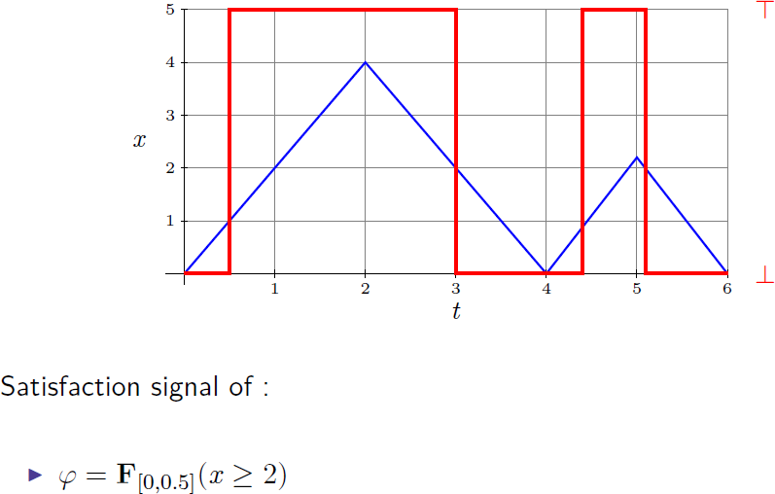
Signal temporal logic
Notes:
23
13/06/2018
Laboratoire Verimag

Slide 24
Stl syntax
Assume signals x1[t], x2[t], …, xn[t], then atomic predicates are of the form
Notes:
24
13/06/2018
Laboratoire Verimag

Slide 25
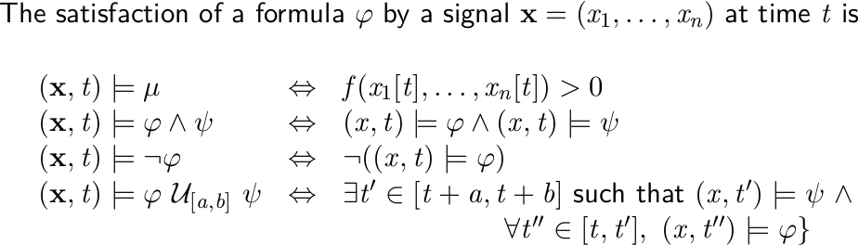
Stl semantics
Notes:
25
13/06/2018
Laboratoire Verimag

Slide 26
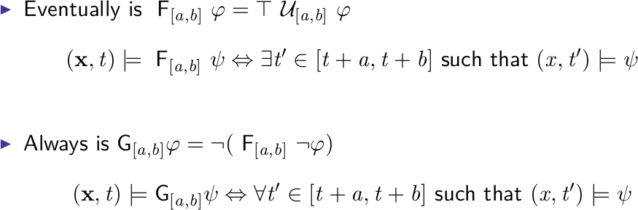
Stl semantics
Notes:
26
13/06/2018
Laboratoire Verimag

Slide 27
Signal temporal logic
LTL:
G( r => F g)
Boolean predicates, discrete-time
MTL:
G( r => F [0,.5s] g )
Boolean predicates, real-time
STL:
G( x[t] > 0 => F [0,.5s] y[t] > 0 )
Predicates over real values, real-time
Notes:
27
13/06/2018
Laboratoire Verimag

Slide 28

Stl example
After 2s, the signal is never above 3
Notes:
28
13/06/2018
Laboratoire Verimag

Slide 29
Temporal Logic
Quantitative Semantics for STL
Notes:
29
13/06/2018
Laboratoire Verimag

Slide 30
Qualitative semantics
Notes:
30
13/06/2018
Laboratoire Verimag

Slide 31
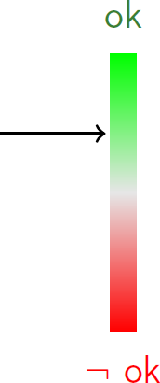
Quantitative semantics
Notes:
31
13/06/2018
Laboratoire Verimag

Slide 32

Quantitative semantics
Notes:
32
13/06/2018
Laboratoire Verimag

Slide 33
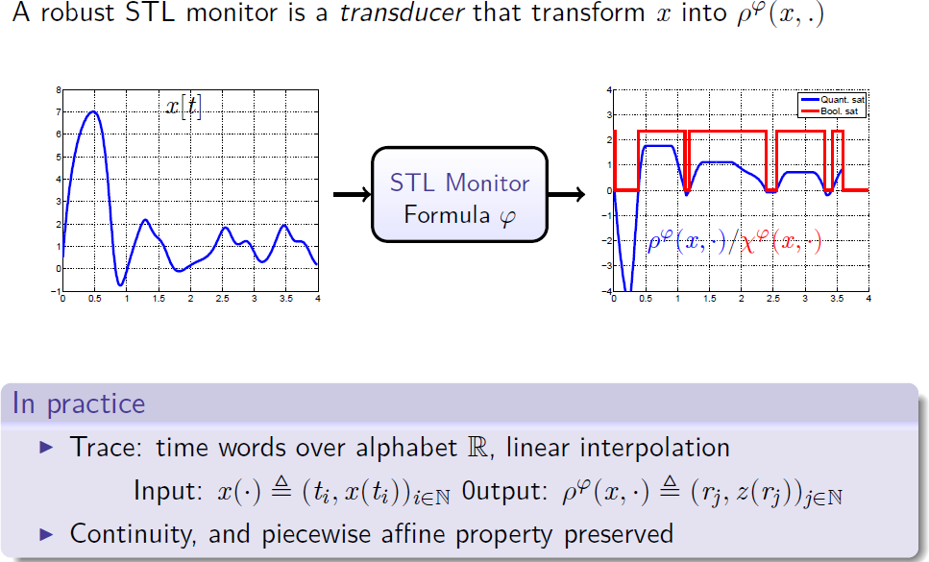
quantitative stl
Notes:
33
13/06/2018
Laboratoire Verimag

Slide 34
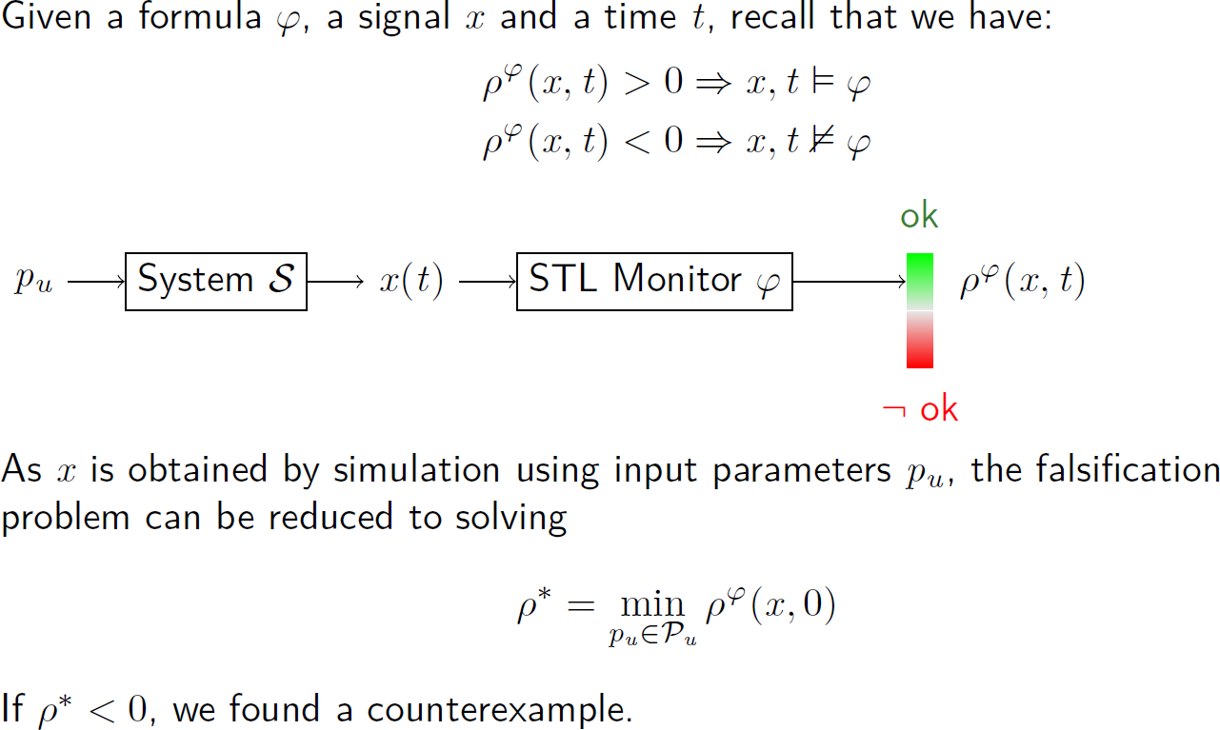
quantitative stl
Notes:
34
13/06/2018
Laboratoire Verimag

Slide 35
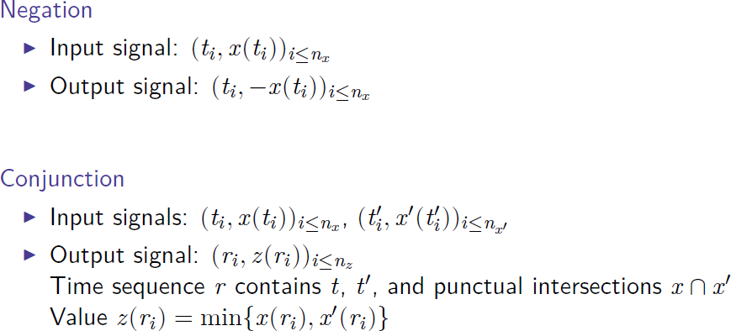
Boolean operators
Notes:
35
13/06/2018
Laboratoire Verimag

Slide 36
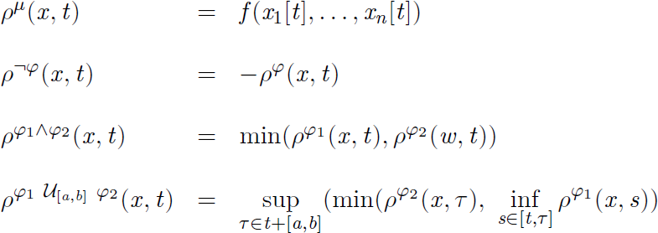
quantitative operators
Notes:
36
13/06/2018
Laboratoire Verimag

Slide 37
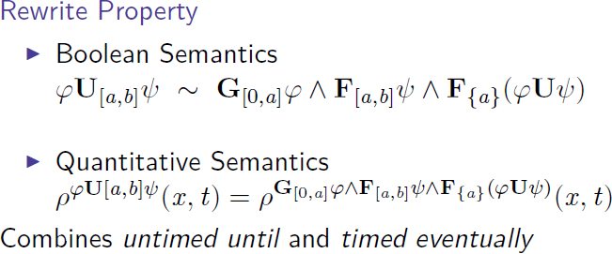
Until operator
Notes:
37
13/06/2018
Laboratoire Verimag

Slide 38
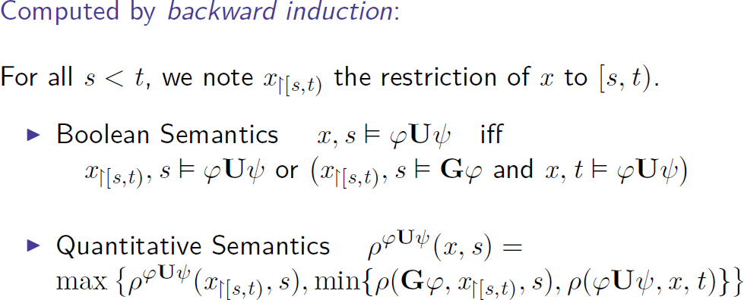
Untimed until
Notes:
38
13/06/2018
Laboratoire Verimag

Slide 39
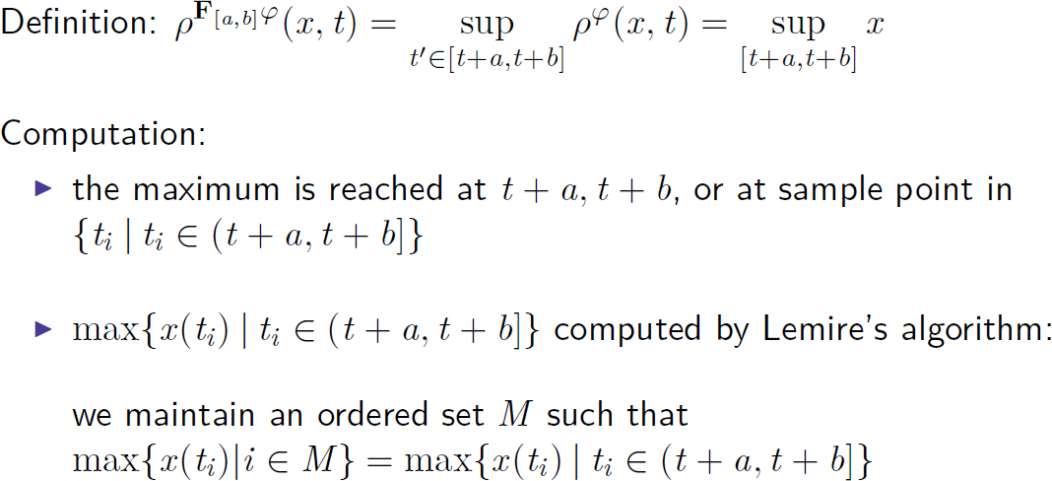
Timed eventually
Notes:
39
13/06/2018
Laboratoire Verimag

Slide 40
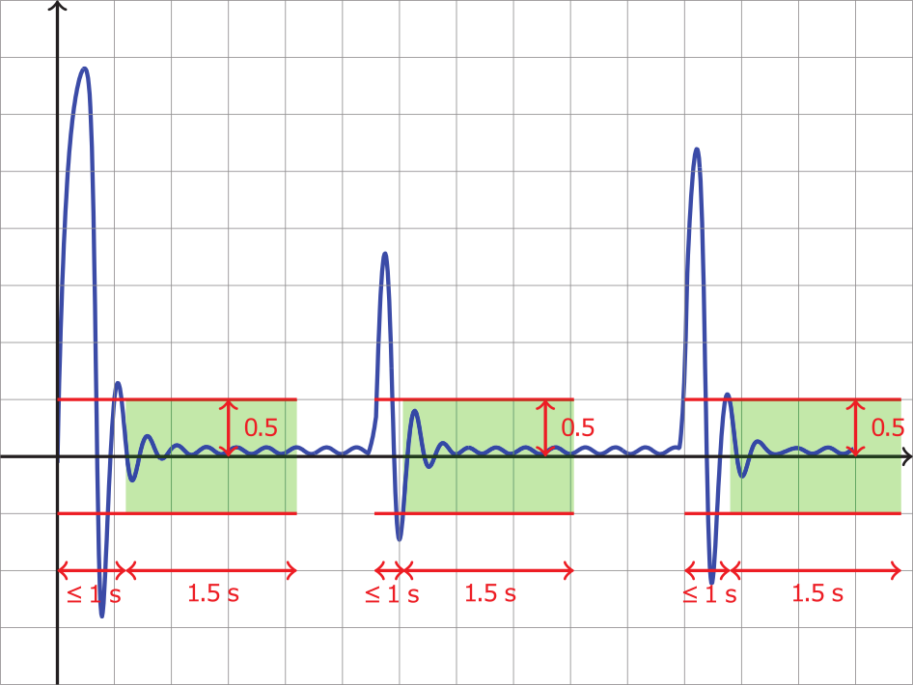
Signal stabilization
Always |x| > 0.5 then after 1s, |x| settles under 0.5 for 1.5 s
Notes:
40
13/06/2018
Laboratoire Verimag

Slide 41
Signal stabilization
Always |x| > 0.5 then after 1s, |x| settles under 0.5 for 1.5 s
Notes:
41
13/06/2018
Laboratoire Verimag

Slide 42
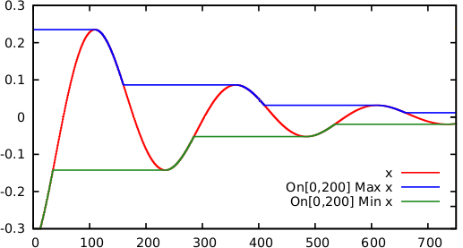

Extended stl
Amplitude |x| $≤$ 0.1 for 200 s
*Bakhirkin, A., & Basset, N.: Specification and Efficient Monitoring Beyond STL. In TACAS 2019. To appear.
Notes:
42
13/06/2018
Laboratoire Verimag

Slide 43
Extended Stl syntax
Notes:
43
13/06/2018
Laboratoire Verimag

Slide 44
Extended Stl syntax
STL + min/max operators
Notes:
44
13/06/2018
Laboratoire Verimag

Slide 45


Extended Stl semantics
Efficient monitoring method for evaluating min/max operators over a signal
Linear cost with respect to the length of the signal
New aggregation functions beyond min/max (e.g., derivative, integral)
Notes:
45
13/06/2018
Laboratoire Verimag

Slide 46

Signal stabilization
Amplitude |x| $≤$ 0.1 for 200 s
Notes:
46
13/06/2018
Laboratoire Verimag

Slide 47
Tools
Tools
Notes:
47
13/06/2018
Laboratoire Verimag

Slide 48
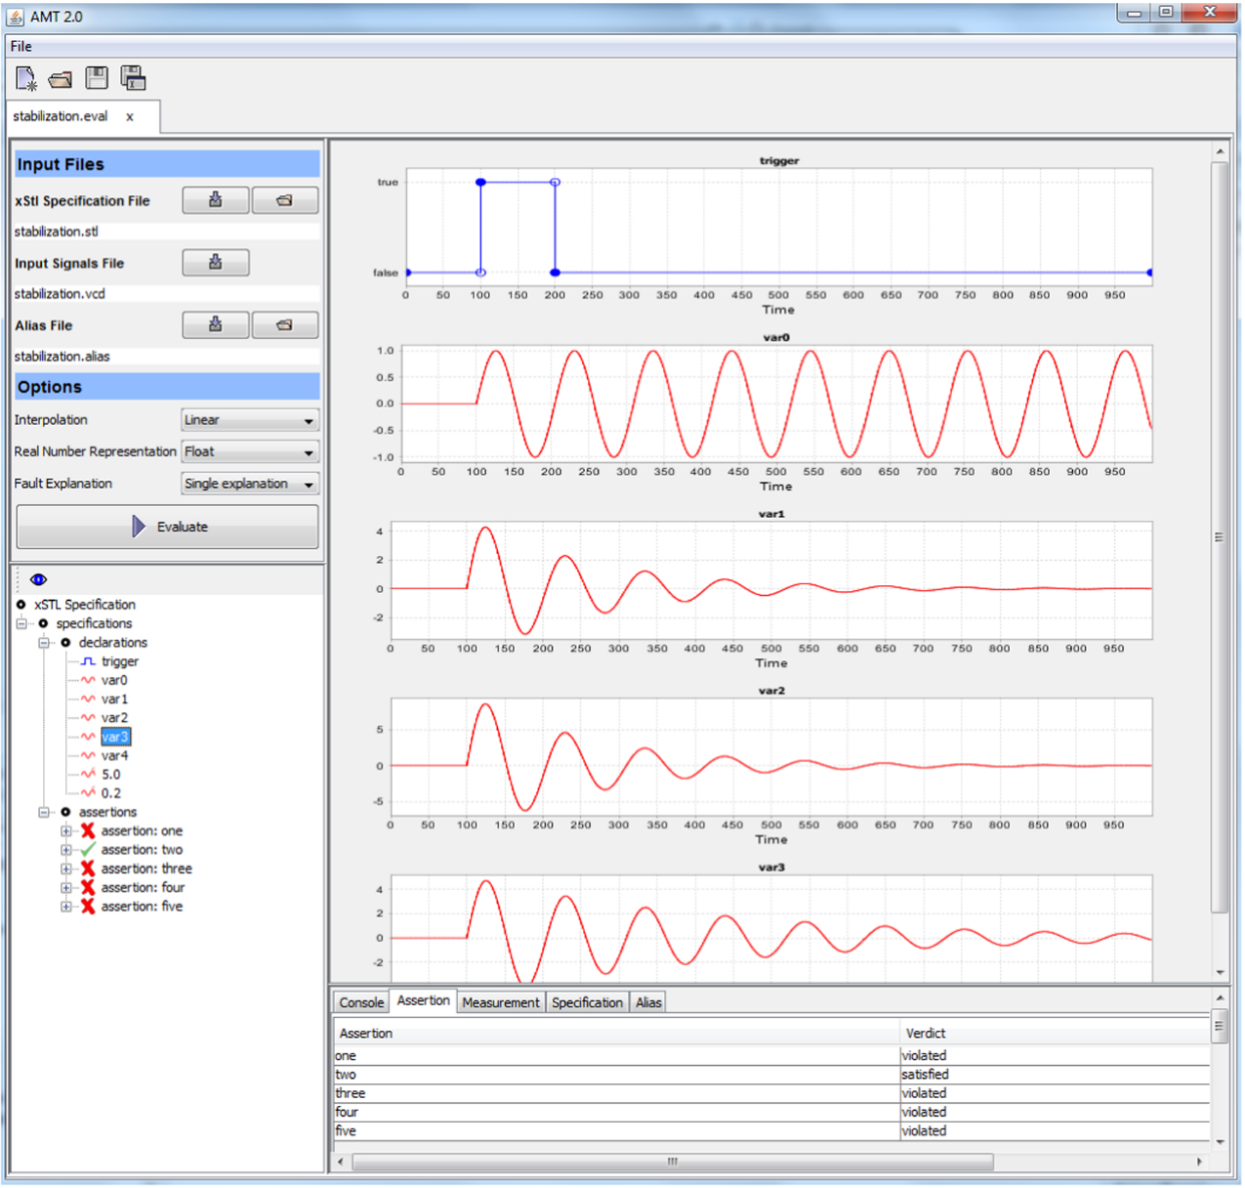
AMT 2.0
Notes:
48
13/06/2018
Laboratoire Verimag

Slide 49
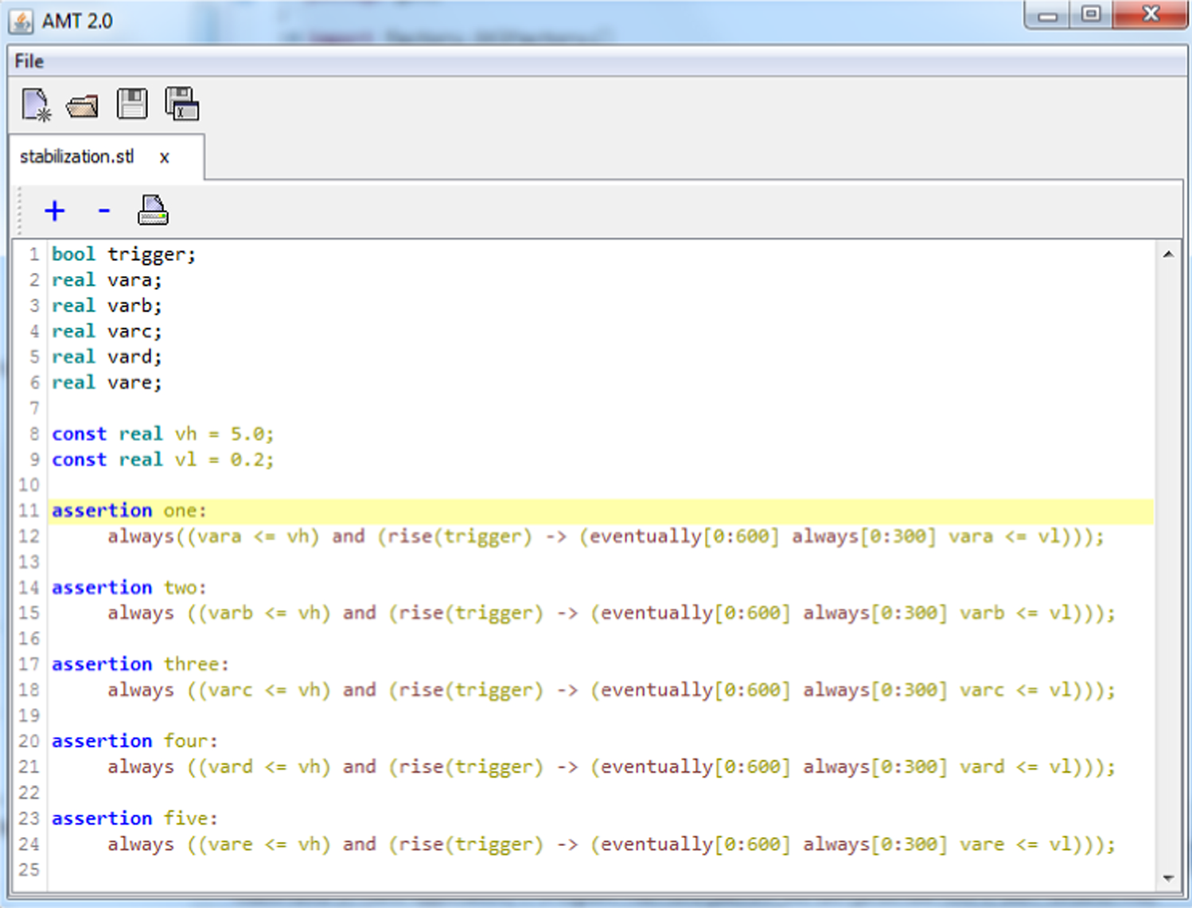
AMT 2.0
Notes:
49
13/06/2018
Laboratoire Verimag

Slide 50
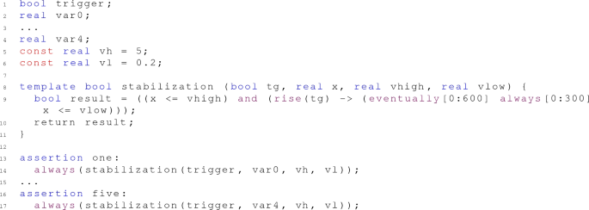
AMT 2.0
Notes:
50
13/06/2018
Laboratoire Verimag

Slide 51
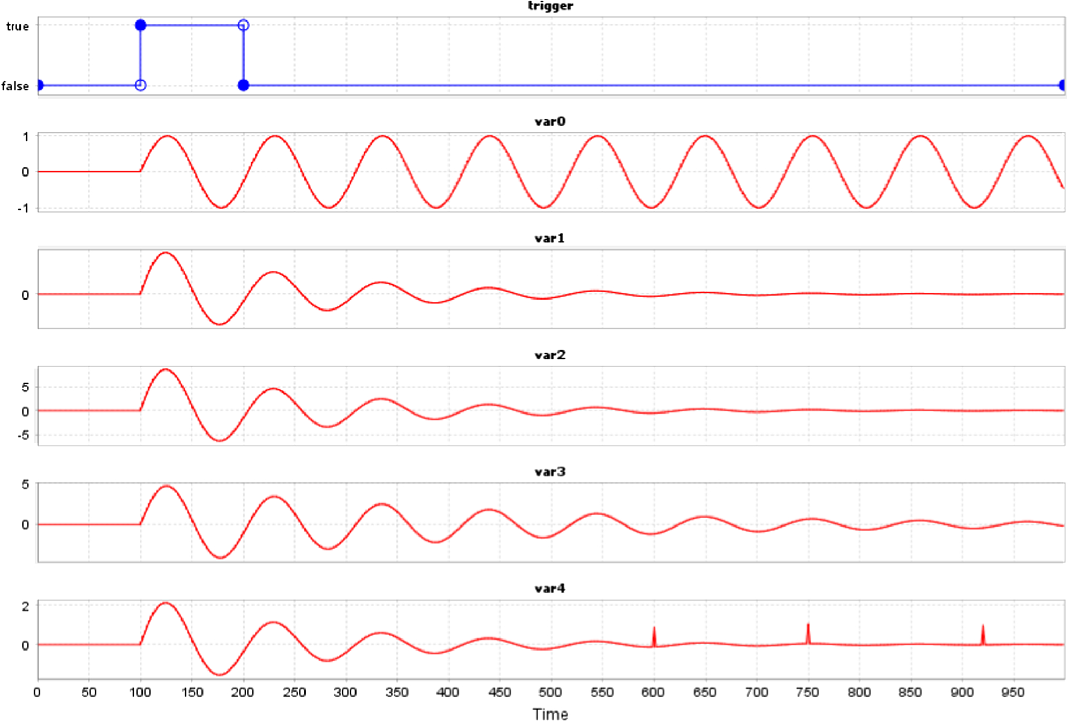
AMT 2.0
Notes:
51
13/06/2018
Laboratoire Verimag

Slide 52
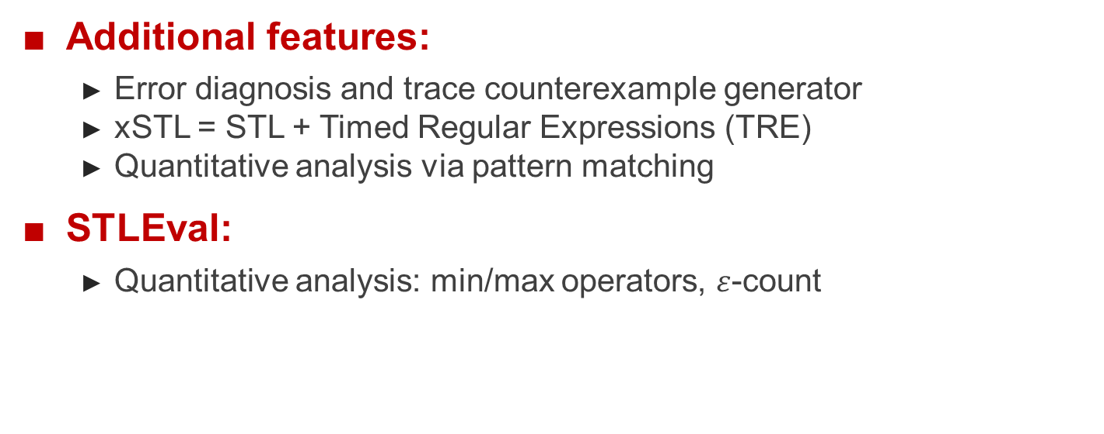
AMT 2.0
Additional features:
Error diagnosis and trace counterexample generator
xSTL = STL + Timed Regular Expressions (TRE)
Quantitative analysis via pattern matching
STLEval:
Quantitative analysis: min/max operators, $ε$-count
Notes:
52
13/06/2018
Laboratoire Verimag

Slide 53

The END
Notes:
53
13/06/2018
Laboratoire Verimag

